Slide 1
Estimating the Undiagnosed Fraction: A new “Testing History” approach
Martina Morris
presenting joint work with
Ian Fellows, PhD (statistics) and
Matt Golden, MD

Slide 2
Motivation
Currently have 2 national estimates of the undiagnosed fraction
Empirical estimate from NHBS for MSM: 44%
Chen M, Rhodes PH, Hall IH, Kilmarx PH, Branson BM, Valleroy LA, Centers for Disease C, Prevention: Prevalence of undiagnosed HIV infection among persons aged >/=13 years--National HIV Surveillance System, United States, 2005-2008. MMWR Morb Mortal Wkly Rep 2012, 61 Suppl:57-64.
Seattle NHBS MSM estimate is ~ 15%
Back-calculation estimate from CDC National HIV surveillance system: 19.1%
Hall HI, Frazier EL, Rhodes P, Holtgrave DR, Furlow-Parmley C, Tang T, Gray KM, Cohen SM, Mermin J, Skarbinski J: Differences in human immunodeficiency virus care and treatment among subpopulations in the United States. JAMA internal medicine 2013, 173(14):1337-1344.

Slide 3
Questions about these estimates
NHBS MSM estimate
Sample is venue based. Representative?
Status awareness is self-report. Non-disclosure?
Local/regional differences from national patterns?
CDC national back-calculation estimate
Method is not well described
Depends on assumptions about the distribution of time from infection to AIDS
Appears to make many other assumptions as well

Slide 4
Goal: A tool for local use
Method based on testing history data only
Back-calculation based approach
Uses HIV Dx + most recent HIV negative test
Can provide software (R) to local Public Health Depts
Will focus on this in the current presentation
Back of the envelope calculation
Based on Matt Golden’s idea
How bad can it be? ☺
Turns out it perfectly matches the back-calculation estimate (under some assumptions)
Can provide excel worksheet to local Public Health Depts

Slide 5
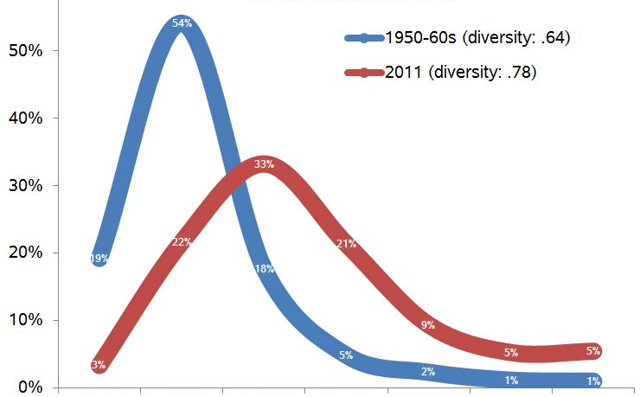
Back calculation: the idiot’s guide
Basic idea
What you see now
Is based on infections that happened in the past
So: can you use new diagnoses to back-calculate what happened in the past?
Imagine smearing the incidence of new HIV infections forward as they are diagnosed over time
Some are diagnosed quickly, other not
What we see now = sum over time of
incidence at time t * probability(Dx at time t+Z )
HIV incidence
HIV Dx
time

Slide 6
Breaking it down
Imagine a Dx always happens within 3 years of HIV infection
25% get Dx at t=1
50% at t=2
25% at t=3
If there was only one year of 10% incidence, the observed HIV Dx curve would look like this:
With only one year of incidence, smeared over 3 years of Dx
For any single year:
Observed Dx ≠ True Incidence
True incidence: 10% in year 1 only

Slide 7
With multiple years of incidence?
Assume the same Dx rates: 25-50-25%
You only observe the total HIV Dx, which is now a mix of cases from previous (up to 3) years
Obs Dx( t+Z ) = sum of (HIV incidence at time t * probability(Dx at time t+Z )

Slide 8
Variants of back-calculation
Standard form
Estimate HIV incidence from AIDS Dx
Assumptions: time from infection to AIDS Dx
“Extended” form
Estimate HIV incidence using both HIV Dx and AIDS Dx
Can also include biomarkers, e.g., CD4, recent infection
Assumptions: time from infection to AIDS Dx, time from infection to HIV Dx, impact of symptoms on testing rate
Our version: “Testing History” method
Estimate undiagnosed fraction from HIV test dates: last – to +
Assumption: time from infection to HIV Dx

Slide 9
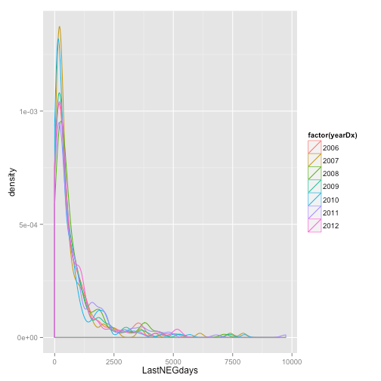
Basic idea
Testing history data:
Time from last negative test to Dx
For HIV Dx with a previous negative test
We know infection must have happened in this interval
If we assume a distribution for the probability of infection in that interval
we can estimate incidence
and the undiagnosed fraction
we’ll examine 2 different assumptions

Slide 10
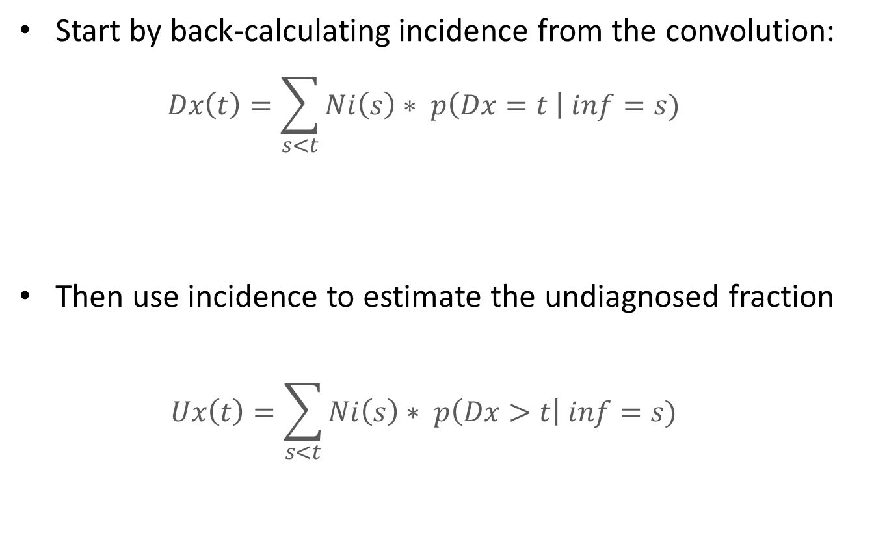
Testing history back-calculation
Start by back-calculating incidence from the convolution:
$$Dx\left(t\right)=\sum_{s<t}{Ni\left(s\right)∗ p\left(Dx=t \right| inf=s)}$$
Then use incidence to estimate the undiagnosed fraction
$$Ux\left(t\right)=\sum_{s<t}{Ni\left(s\right)∗ p\left(Dx>t\right| inf=s)}$$
Diagnosed cases
at time t
(known)
Number of incident
cases at time s
(unknown)
* Probability of diagnosis at time t
given infected at time s
(assumed, based on test history)

Slide 11
Sensitivity to assumptions
Assumptions can influence estimates, so we explore different assumptions
First: Time from Infection to HIV Dx (the TID distribution)
Base case: assume uniform distribution of infection across interval
Upper bound: assume infection immediately after last negative test.
Second: Incidence change over time
Time varying (each year can be different)
Constant (the estimating equation then simplifies dramatically)

Slide 12
Application
To all new MSM HIV Dx in King County
85% of new Dx are in MSM in KC
Most MSM have a previous negative test
Timeframe: 2006-2012
3 sources of data on testing history
eHARS: only includes validated test histories
HIS: CDC testing and Tx history Qx (self report to DIS)
PS: Partner services data (self report to DIS)

Slide 13
Testing Data
New MSM diagnoses 2006-12: 1522
Testing history:
~88% known
Sourced from:
25% eHARS
71% HIS
31% Partner Services
Correlations: (HIS,eHars) = .76; (HIS,PS) = 0.85

Slide 14
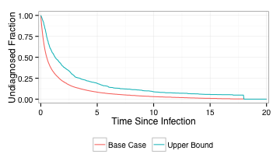
Estimates of TID (dist’n of time from infection to HIV Dx)
Median estimates of TID: Base case = 0.5 years
Upper bound = 1.3 years
Empirical estimates of possible infection interval: Mean = 3.12 years
Median = 1.25 years

Slide 15
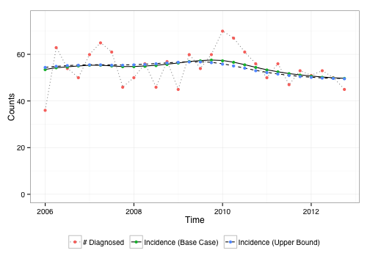
Incidence Count Estimates
No difference between base case and upper bound

Slide 16
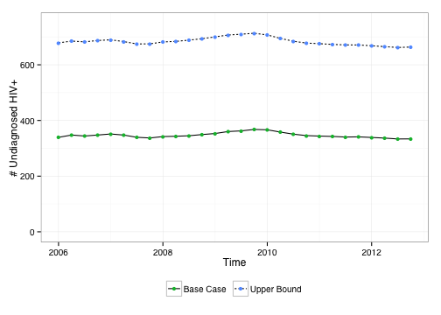
Estimated Undiagnosed Cases (Count)
Upper bound estimate is ~double the base case

Slide 17
Undiagnosed fraction estimates
TID Distribution Assumption | Incidence Model | Estimated Number of MSM with HIV | Estimated Number of MSM with undiagnosed HIV | Undiagnosed Fraction
Base case | Varying | 5850-5884 | 333-368 | 5.7%-6.3%
 | Constant | 5863 | 347 | 5.9%
Upper bound | Varying | 6178-6229 | 662-713 | 10.7%-11.4%
 | Constant | 6203 | 687 | 11.1%
Assumptions matter, but both estimates are quite low: 5.9 – 11.1%

Slide 18
Undiagnosed fractions: by race/ethnicity

Slide 19
Key strengths of this approach
Compared to other back-calculation approaches:
This approach does not use data on AIDS Dx
So we don’t need to make assumptions about the time from infection to AIDS
This approach uses the observed testing frequency
So we don’t need to make assumptions about rate of testing, and whether it changes over time
And changes in test frequency will be accurately reflected by the estimate

Slide 20
Limitations
Of the approach
Need robust testing history data : 81% have a last negative test date in the Seattle data
The sensitivity of this estimate to the TDI assumptions will increase as the number of cases with no prior test data rises.
One could potentially model this with missing data methods
We assume testing is not correlated to risk behavior
But if recent risk leads to testing, then the undiagnosed fraction is probably lower than the base case estimate
This, too, can be modeled
Of the Seattle analysis
Only 25% of our cases have a chart-validated last negative test date
But the correlations of the self-report dates with eHARS suggest good validity for the rest

